Slide 1
Selective Service Outreach to Social Workers

Slide 2
Why should young men register?
Pat Schuback, Public Affairs Specialist
Selective Service System
1515 Wilson Blvd, 5th Floor
Arlington, VA 22209-2425
TEL: (703) 605-4105
pat.schuback@sss.gov
It’s the law.
Failing to register can result in significant lost opportunities for young men, including:
Being barred from receiving student loans
Being barred from participating in federal job training programs
Being unable to secure employment with the Federal government, as well as many state and local government agencies such as police, EMTs and firefighters
Receiving or renewing a driver’s license in most states
Experiencing challenges in receiving U.S. citizenship if he is an immigrant wishing to become a citizen

Slide 3
Our research tells us that when young men don’t register, it’s because they don’t know they have to. That’s why we need you.
Pat Schuback, Public Affairs Specialist
Selective Service System
1515 Wilson Blvd, 5th Floor
Arlington, VA 22209-2425
TEL: (703) 605-4105
pat.schuback@sss.gov

Slide 4
Why we need you:
Pat Schuback, Public Affairs Specialist
Selective Service System
1515 Wilson Blvd, 5th Floor
Arlington, VA 22209-2425
TEL: (703) 605-4105
pat.schuback@sss.gov
Social workers strive to help clients live up to their full potentials.
Even though Selective Service registration only takes two minutes, it can mean a lifetime of opportunities.
By explaining the legal requirement of registration to every young man you work with, you can ensure that there is one less obstacle in their path to success.

Slide 5
Who needs to register?
Pat Schuback, Public Affairs Specialist
Selective Service System
1515 Wilson Blvd, 5th Floor
Arlington, VA 22209-2425
TEL: (703) 605-4105
pat.schuback@sss.gov
All young men living in the United States between the ages of 18-26, including non-citizens.

Slide 6
How can young men register?
Pat Schuback, Public Affairs Specialist
Selective Service System
1515 Wilson Blvd, 5th Floor
Arlington, VA 22209-2425
TEL: (703) 605-4105
pat.schuback@sss.gov
Log on to www.SSS.gov
Fill out a registration
card at a US Post Office.

Slide 7
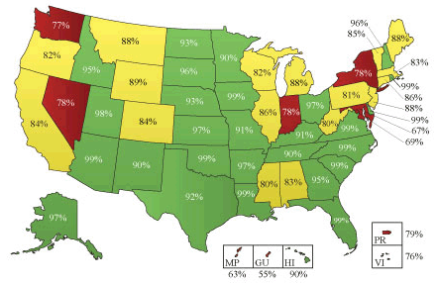
Registration in Your State
Pat Schuback, Public Affairs Specialist
Selective Service System
1515 Wilson Blvd, 5th Floor
Arlington, VA 22209-2425
TEL: (703) 605-4105
pat.schuback@sss.gov
On average, 1 out of every 10 men in the U.S. aged 18 is not registered. Find the rates for your state below.
*based on 2013 data

Slide 8
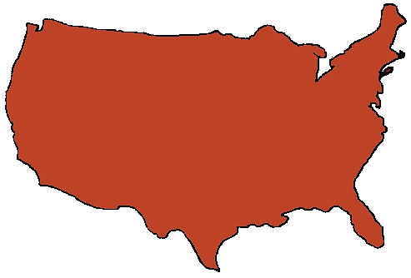
Registration and Drivers Licenses
Pat Schuback, Public Affairs Specialist
Selective Service System
1515 Wilson Blvd, 5th Floor
Arlington, VA 22209-2425
TEL: (703) 605-4105
pat.schuback@sss.gov
In these states, men over 18 must be registered with Selective Service in order to receive or renew their driver’s license. Other states are working to enact similar legislation.
Alabama
Arizona
Arkansas
Colorado
Connecticut
District of Columbia
Delaware
Florida
Georgia
Hawaii
Idaho
Illinois
Indiana
Iowa
Kansas
Kentucky
Louisiana
Maine
Maryland
Michigan
Minnesota
Mississippi
Missouri
Montana
Nevada
New Hampshire
New Mexico
New York
North Carolina
Ohio
Oklahoma
Rhode Island
South Carolina
South Dakota
Tennessee
Texas
Utah
Virginia
Washington
West Virginia
Wisconsin

Slide 9
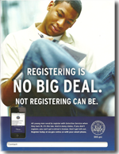
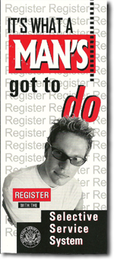
How you can help
Pat Schuback, Public Affairs Specialist
Selective Service System
1515 Wilson Blvd, 5th Floor
Arlington, VA 22209-2425
TEL: (703) 605-4105
pat.schuback@sss.gov
Educate the young men and families with whom you work.
Put up posters
Hand out brochures
Include articles in your publications (online or print newsletter, website, magazine, etc.)
Post banner ads or include ready-to-use advertisements in your websites and publications.
Educate other organizations who work with young men.

Slide 10
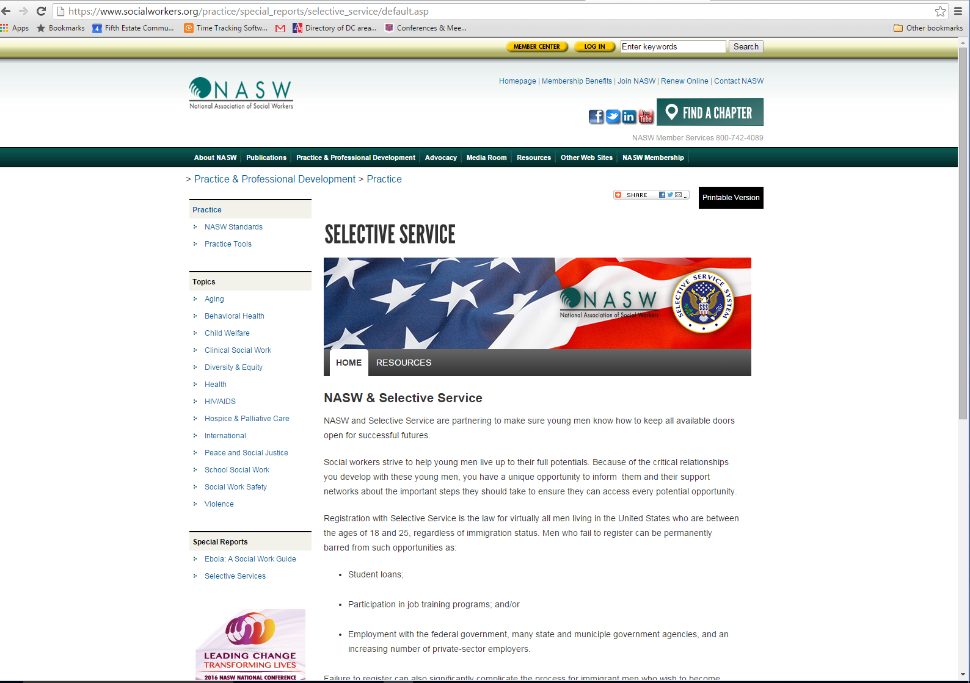
Where to get Educational Material
Pat Schuback, Public Affairs Specialist
Selective Service System
1515 Wilson Blvd, 5th Floor
Arlington, VA 22209-2425
TEL: (703) 605-4105
pat.schuback@sss.gov
Join the Selective Service System’s communications network to receive quarterly e-mails.
Use free resources posted on the NASW toolkit
Go to https://www.sss.gov/Public-Affairs/Resources to print or order
free educational materials.

Slide 11
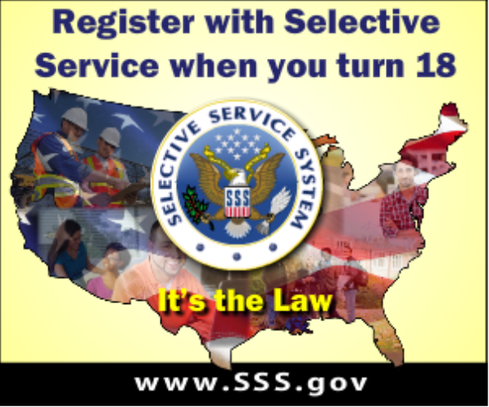
Questions?
Pat Schuback, Public Affairs Specialist
Selective Service System
1515 Wilson Blvd, 5th Floor
Arlington, VA 22209-2425
TEL: (703) 605-4105
pat.schuback@sss.gov
Please contact Pat Schuback
Public Affairs Specialist,
Selective Service
pat.schuback@sss.gov
(703) 605-4105

